Slide 1

ComplAI
AI Powered Regulatory Compliance Tool
Group 11

Slide 2
AGENDA
01
04
02
05
03
06
MARKET PAIN POINTS
OUR TEAM
07
COST & ROI
COMPETITORS
THE PRODUCT
08
THE CUSTOMER
THE IDEA
MARKET ANALYSIS
09
GO/NO GO?

Slide 3
MARKET PAIN POINTS
Human consultant limitations – Bias, Cost and Availability, Human Error, Standardization
Lack of Customization
Complex User Interfaces
Limited Integration Capabilities
Ineffective Communication of Regulatory Changes
Insufficient Analytics
Poor Document Management and Version Control
Inadequate NLP Capabilities
Limited Support for Cross-Border Compliance
Inadequate Training and Education Resources
Limited Collaboration and Communication Features

Slide 4
COMPETITORS
DIRECT COMPETITORS
INDIRECT COMPETITORS
Connected GRC Compliance Tracking Audit Management Risk Management Third-Party Vendor Management
MetricStream
Navex Global
Analytics and Benchmarking Conflict of Interest Identification Process-related Risk Management
VComply
Information Security Management Operational Risk Identification and Mitigation Risk and Control Assessments Governance Establishment
Consultancies
Assessment and Strategy Process Optimization Cybersecurity Integration Strategic advisory

Slide 5



COMPETITION COMPARISON
 | FEATURES | PRICING
Metricstream | One-time license | $100,000 lifetime
NAVEX | Basic with demo | $5000/year
VCOMPLY | Starter and Pro version | $14,388 - $23,988/year

Slide 6
USER FEEDBACK
Following are the main issues highlighted in the customer feedback of different Regulatory Compliance tools-:
Operational and User Experience Troubles
Complex Maintenance
Worries about cost
Difficulties with integration
Weaknesses in managing governance, risk and compliance

Slide 7

ComplAI – THE IDEA
To create an AI powered tool to ensure fintech MSMEs achieve regulatory compliance

Slide 8
OUR TEAM
Manu Vats
Quoc Tran (Kyle)
Sunny Purswani
Rakshith Ramureddy
Chief Executive Officer
Chief Marketing Officer
Chief Technology Officer
Chief Financial Officer
Ridhima Thakur
Chief Information Officer

Slide 9
PRODUCT MVP
Monitoring of regulatory changes
AI Workflow designs with customization options
NLP to interpret and extract key information from regulatory texts.
AI Reporting
Predictive analytics
Centralized repository for documents with basic version control.
Integration with email systems and existing systems
Intuitive and user-friendly interface design.
Access to basic training materials within the tool.
Basic collaboration tools, such as document sharing and basic task assignment.

Slide 10
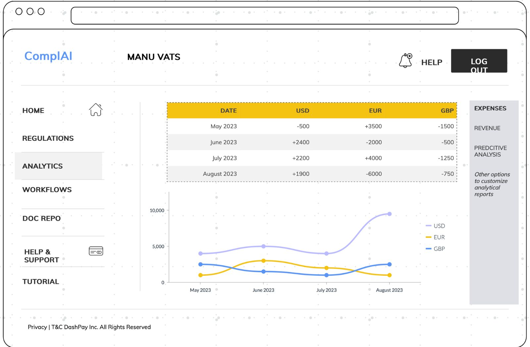
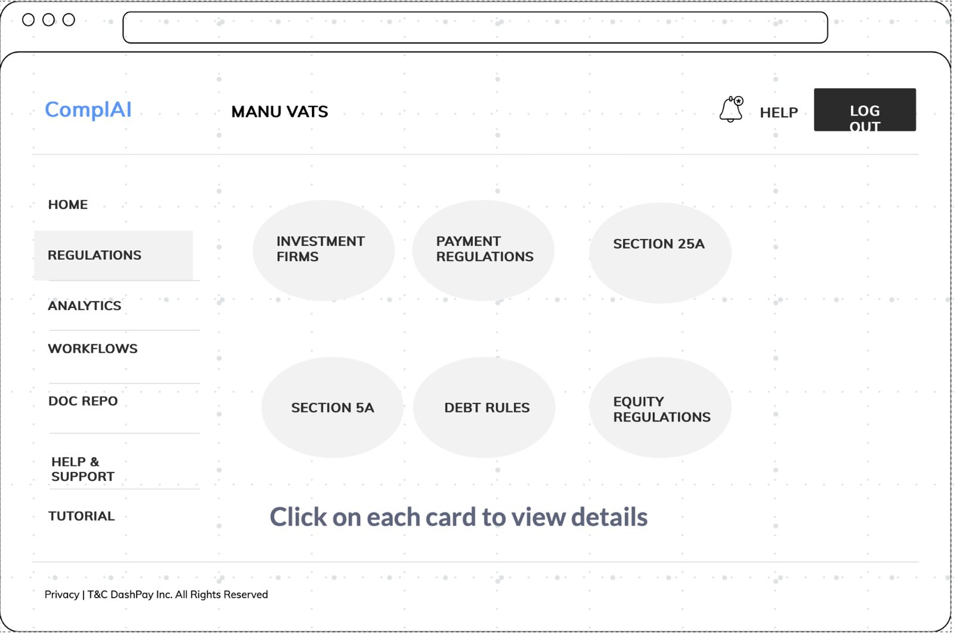
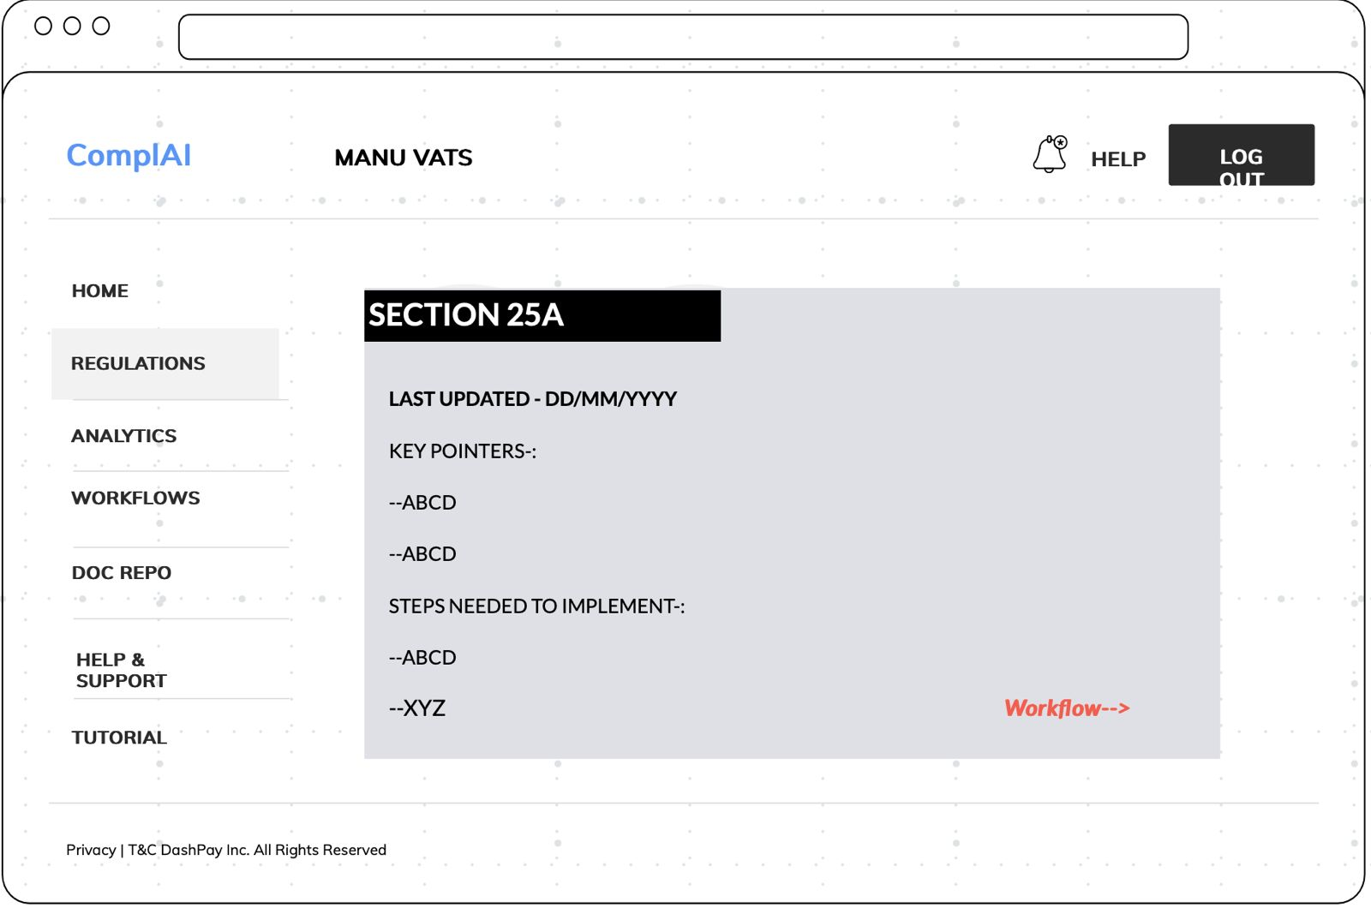
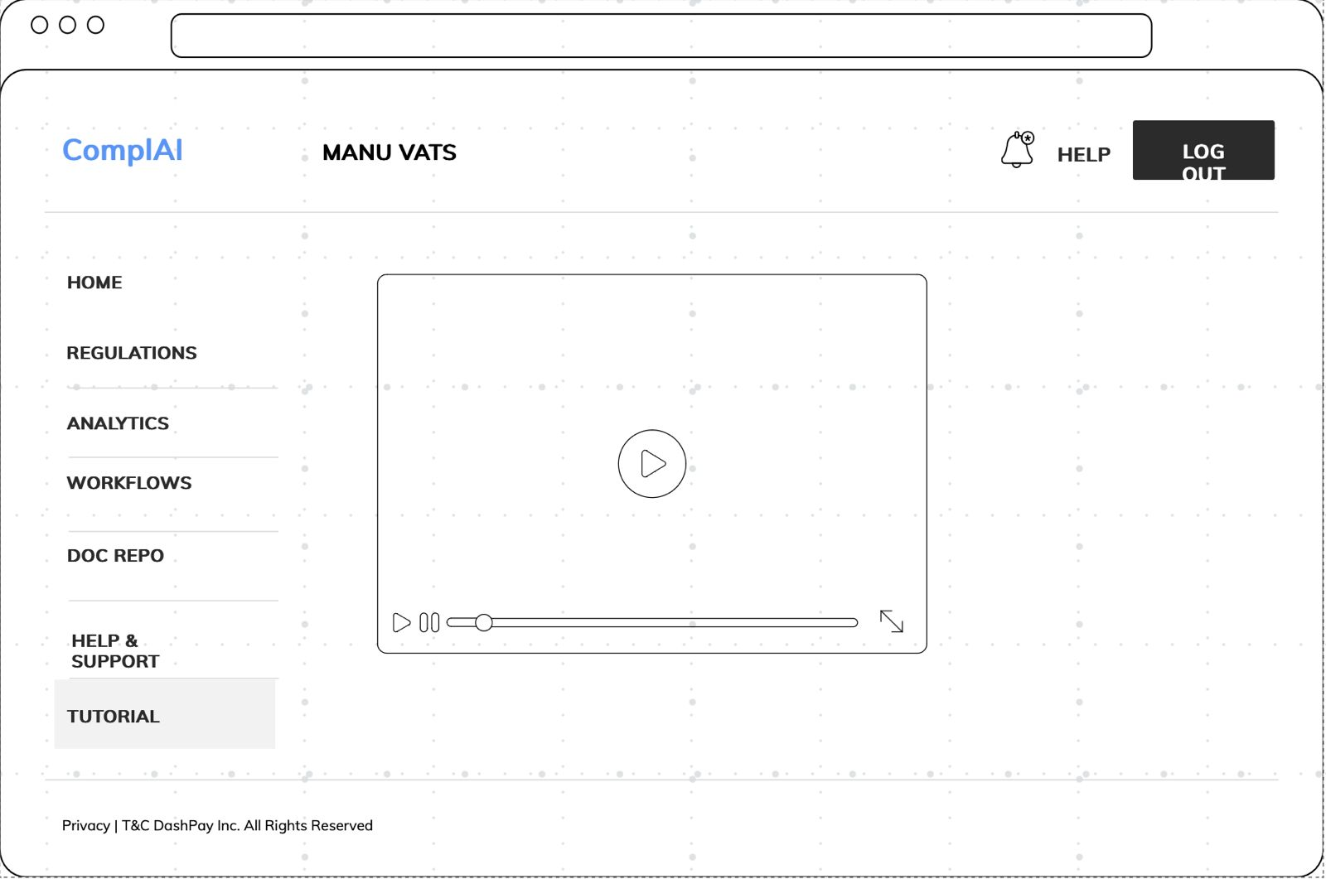
WIREFRAME

Slide 11
USP – AI POWERED FUNCTIONALITIES
MONITORING OF REGULATORY CHANGES
AI WORKFLOW DESIGNS WITH CUSTOMIZATION OPTIONS
NLP TO EXTRACT INFORMATION FROM REGULATORY TEXTS.
PREDICTIVE ANALYTICS
AI REPORTING

Slide 12
MARKET SIZE OVERVIEW
TAM – Total Revenue Theoretically
$1.94B
Overall companies in MSME segment is 202,130 in the UK. Total Addressable Market is $1.94B
SAM – Willingness to Pay
$25.6M
SOM – Realistically the Business can Serve
Of which 2671 Fintech MSMEs in UK alone. That is 1.3% of TAM. Serviceable Accessible Market is $25.6M
If a minimum of 134 companies (5% of SAM) were to be targeted in the first year. A revenue of $1.62M can be generated.
$1.62M

Slide 13

ROI
If 5% (roughly 134 customers) of SAM invests in our product at $800pcm within the UK in the 1st year then the net revenue is estimated to be $1.61M with a ROI of 61.6% for the 1st year at an approximate investment of $1M. With an added expense of $200K approx. every year then we observe a annualized ROI of 25.75% at the end of 5 years with an assumption that 20% rise in number of customers.

Slide 14
CUSTOMER PROFILE
We are targeting MSME customer segment for our product.
SIZE (No. of Employees) | 10 to 50
REVENUE (million USD) | 1 to 15
INDUSTRY | FINTECH
LOCATION | UNITED KINGDOM
TECHNOLOGY ADOPTION | Advanced tech infrastructure and high digital maturity
GOALS AND OBJECTIVES | To minimize costs and scale their business
COMMUNICATION CHANNELS | Social media, Industry events, Online platforms, Business events
DECISION MAKERS | Founders and CXOs

Slide 15
GO / NO GO?

Slide 16
THANKS!

